Slide 1
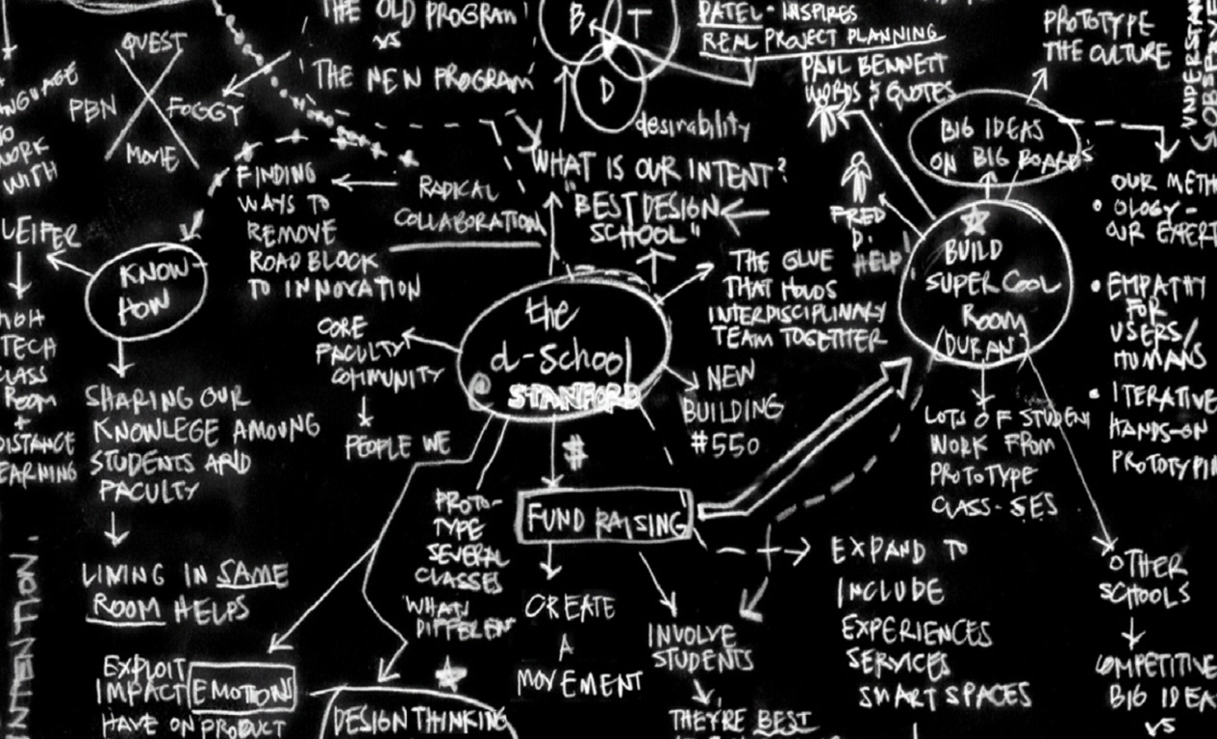
Design Thinking About Viability

Slide 2
How does design thinking intersect
with business considerations?

Slide 3
When should we think about profitability?

Slide 4
Design + Entrepreneurship

Slide 5
is
Design + Entrepreneurship

Slide 6
an extremely effective way of being an
is
Design + Entrepreneurship

Slide 7
an extremely effective way of being an
is
Design + Entrepreneurship
acts on opportunity without regard to resources

Slide 8
an extremely effective way of being an
is
Design + Entrepreneurship
acts on opportunity without regard to resources
bias towards action

Slide 9
an extremely effective way of being an
is
Design + Entrepreneurship
acts on opportunity without regard to resources
bias towards action
limited resources,
especially time and $

Slide 10
an extremely effective way of being an
is
Design + Entrepreneurship
acts on opportunity without regard to resources
bias towards action
limited resources,
especially time and $
risk
reward

Slide 11
an extremely effective way of being an
is
Design + Entrepreneurship
acts on opportunity without regard to resources
bias towards action
limited resources,
especially time and $
H2 take appropriate s
risk
reward

Slide 12
an extremely effective way of being an
is
Design + Entrepreneurship
acts on opportunity without regard to resources
bias towards action
limited resources,
especially time and $
Identify & eliminate key risks
within time and capital constraints
H2 take appropriate s
risk
reward

Slide 13
an extremely effective way of being an
is
Design + Entrepreneurship
acts on opportunity without regard to resources
bias towards action
limited resources,
especially time and $
Identify & eliminate key risks
within time and capital constraints
H2 take appropriate s
risk
reward
low-res prototyping
+
iteration

Slide 14
an extremely effective way of being an
is
Design + Entrepreneurship
acts on opportunity without regard to resources
bias towards action
limited resources,
especially time and $
Identify & eliminate key risks
within time and capital constraints
H2 take appropriate s
risk
reward
low-res prototyping
+
iteration
fail early & often

Slide 15
an extremely effective way of being an
is
Design + Entrepreneurship
acts on opportunity without regard to resources
bias towards action
limited resources,
especially time and $
Identify & eliminate key risks
within time and capital constraints
H2 take appropriate s
risk
reward
low-res prototyping
+
iteration
fail early & often
early failures cost less
+
risk falls with each cycle

Slide 16
an extremely effective way of being an
is
Design + Entrepreneurship
acts on opportunity without regard to resources
bias towards action
limited resources,
especially time and $
Identify & eliminate key risks
within time and capital constraints
H2 take appropriate s
risk
reward
low-res prototyping
+
iteration
fail early & often
engage users
early failures cost less
+
risk falls with each cycle

Slide 17
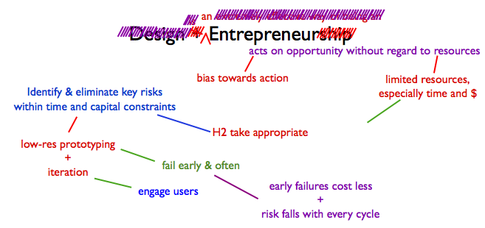
risk
reward

Slide 18
Venture Financing
a
b
(time→) c

Slide 19
Venture Financing
id key risks
a
b
(time→) c

Slide 20
Venture Financing
id key risks
$
a
b
(time→) c

Slide 21
Venture Financing
id key risks
expensive
$
reducing key risks
a
b
(time→) c

Slide 22
Venture Financing
id key risks
expensive
$
reducing key risks
a
increasing valuation
b
(time→) c

Slide 23
Venture Financing
id key risks
id key risks
expensive
$
reducing key risks
a
increasing valuation
b
(time→) c

Slide 24
Venture Financing
id key risks
id key risks
expensive
cheap
$
reducing key risks
$
a
increasing valuation
b
(time→) c

Slide 25
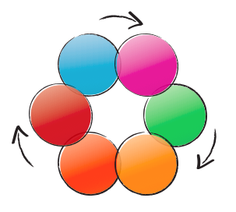
Venture Financing
id key risks
id key risks
expensive
cheap
$
reducing key risks
$
a
increasing valuation
b
(time→) c
Notes:
Investment is expensive for you as an entrepreneur at the beginning because a vc can by more of your company with less money before you reduce key risks.

Slide 26
anyone attempting to get support for an idea
Venture Financing
id key risks
id key risks
expensive
cheap
$
reducing key risks
$
a
increasing valuation
b
c

Slide 27
anyone attempting to get support for an idea
Venture Financing
could be a start-up, or
could be a “rogue” internal
effort within a larger org,
could be a movie script…
id key risks
id key risks
expensive
cheap
$
reducing key risks
$
a
increasing valuation
b
c

Slide 28
So, design thinking is a method and a framework for…

Slide 29
Generating & Evaluating Business Opportunities
Entrepreneurial and Otherwise
Feasibility
Viability
Desirability & Usability
Notes:
Design thinking is a method by which one can evaluate business opportunities, entrepreneurial and otherwise

Slide 30
Generating & Evaluating Business Opportunities
Entrepreneurial and Otherwise
Feasibility
Viability
Adoption
Risk
Desirability & Usability

Slide 31
Generating & Evaluating Business Opportunities
Entrepreneurial and Otherwise
Feasibility
Viability
Adoption
Risk
Desirability & Usability
Will the dog eat the dog food?
Does it address a major pain point?

Slide 32
Generating & Evaluating Business Opportunities
Entrepreneurial and Otherwise
Feasibility
Viability
Adoption
Risk
Desirability & Usability
Will the dog eat the dog food?
Does it trigger a new “pain point?”
i.e. render the status quo unacceptable
Does it address a major pain point?

Slide 33
Generating & Evaluating Business Opportunities
Entrepreneurial and Otherwise
Feasibility
Viability
Adoption
Risk
Does the dog need a sweater?
Desirability & Usability
Will the dog eat the dog food?
Does it trigger a new “pain point?”
i.e. render the status quo unacceptable
Does it address a major pain point?

Slide 34
Generating & Evaluating Business Opportunities
Entrepreneurial and Otherwise
Feasibility
Viability
Adoption
Risk
Is the dog actually a cat?
Desirability & Usability
Will the dog eat the dog food?
Does it trigger a new “pain point?”
i.e. render the status quo unacceptable
Does it address a major pain point?

Slide 35
Generating & Evaluating Business Opportunities
Entrepreneurial and Otherwise
Feasibility
Viability
Business
Risk
Adoption
Risk
Desirability & Usability

Slide 36
Generating & Evaluating Business Opportunities
Entrepreneurial and Otherwise
Feasibility
Viability
Business
Risk
Will the dog hunt?
Do the economics work?
Is the risk worth the reward?
Is it sustainable?
Adoption
Risk
Desirability & Usability

Slide 37
Generating & Evaluating Business Opportunities
Entrepreneurial and Otherwise
Feasibility
Viability
Technology
Risk
Business
Risk
Adoption
Risk
Desirability & Usability

Slide 38
Generating & Evaluating Business Opportunities
Entrepreneurial and Otherwise
Feasibility
Viability
Technology
Risk
Business
Risk
Can we make it?
Will it work?
Is it possible?
Adoption
Risk
Desirability & Usability

Slide 39
Generating & Evaluating Business Opportunities
Entrepreneurial and Otherwise
Feasibility
Viability
Technology
Risk
Business
Risk
Team
Risk
Adoption
Risk
Desirability & Usability

Slide 40
Generating & Evaluating Business Opportunities
Entrepreneurial and Otherwise
Feasibility
Viability
Technology
Risk
Business
Risk
Team
Risk
Should I bet on this team?
Adoption
Risk
Desirability & Usability

Slide 41
How does a team leverage the various lenses?

Slide 42
Feasibility
Viability
Desirability
& Usability
Notes:
All lenses need to be brought to bear upon solutions that are generated through the design process. We strongly encourage you to start at human values, but (being conscious of timing and process), your team must eventually get to examining your ideas through a viability and feasibility lens. It is very important to not impose these lenses too early, as they tend to inhibit team generativeness, but eventually, they become equally valuable inputs into the iteration process.

Slide 44
+ Story

Slide 45
+ Story

Slide 46
+ Story

Slide 47
+ Story

Slide 48
+ Story

Slide 49
+ Story

Slide 50
+ Story

Slide 51
+ Story

Slide 52
+ Story

Slide 53
+ Story

Slide 54

+ Story

Slide 55
Start from any frame, but design that
matters requires that all be applied

Slide 56
?
X
X
Notes:
Can anybody think of a product that’s technologically feasible, but doesn’t consider human values or viability?

Slide 57
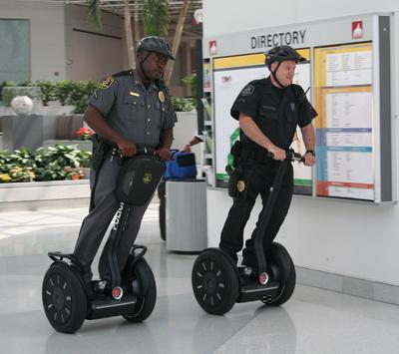
X
X
Notes:
The reason you only see cops riding Segways is that municipalities are the only price-insensitive buyer heartless enough to force their employees to undergo such torture.

Slide 58
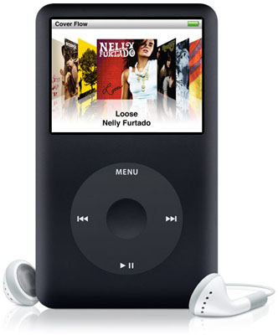

Slide 59
Feasibility
Viability
Desirability
& Usability

Slide 61
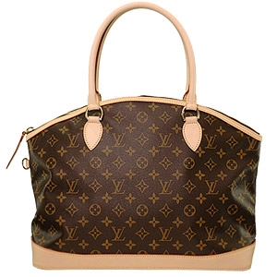
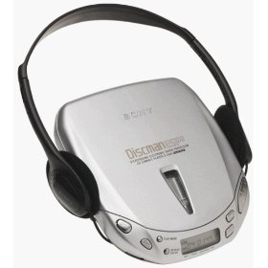
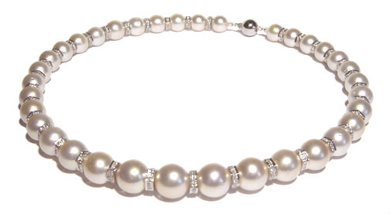

Status symbol
Jewelry
Portability

Slide 63
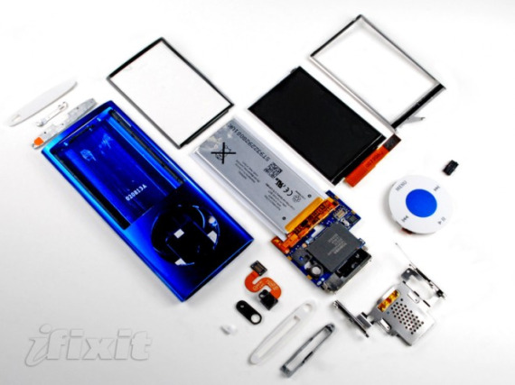

Slide 65
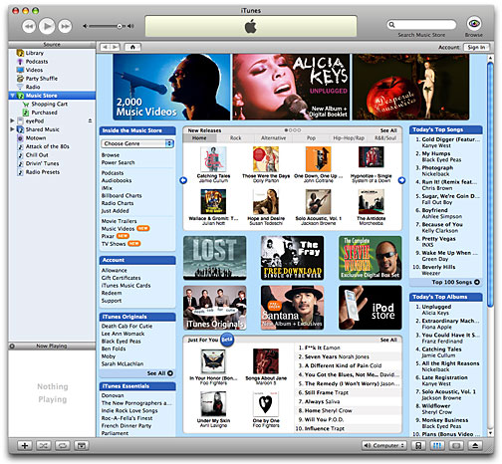

Slide 66
How does this play out for d.school student groups?

Slide 67
Simplistic Example: BioDesign

Slide 68
Family Mobility
Experience

Slide 69
+ Story
Frail Grandmother
+
Busy Student
Long distance
touch
Hug as email

Slide 70
+ Story

Slide 71
Resolution
+
Size
is
Critical
Haptics
Experts
+ Story

Slide 72
Resolution
+
Size
is
Critical
Haptics
Experts
+ Story

Slide 73
+ Story
Hug?
Frail Grandmother
+
Busy Student
Light Touch?
Hand-holding?

Slide 74
+ Story
Hug?
Military Families
Light Touch?
Hand-holding?

Slide 75
Investors
+ Story
Military Families

Slide 76
Military cannot
be primary
customer
Investors
+ Story
Military Families

Slide 77
Military cannot
be primary
customer
Investors
+ Story
Determine new
target market

Slide 78
+ Story
Test with New
User Populations

Slide 79
Risks
BioDesign
BizS356
3 Days
vs.
6 Months

Slide 80
Nuanced Example: D.light

Slide 82
Burma

Slide 83
+ Story
deeply impoverished
reading by candlelight
Burmese Villager

Slide 84
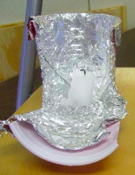
+ Story
deeply impoverished
reading by candlelight
Burmese Villager

Slide 85
+ Story

Slide 86
Light &
Manufacturing
Experts

Slide 87
LED
battery
Light &
Manufacturing
Experts
1M→$5
(price is
critical
function)

Slide 88
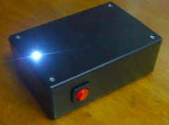
LED
battery
Light &
Manufacturing
Experts
1M→$5
(price is
critical
function)
+ Story

Slide 89
+ Story
Revisit users
Burmese Villager
$5 max

Slide 90
More proto testing of different technologies
Burmese Villager
$5 max

Slide 91
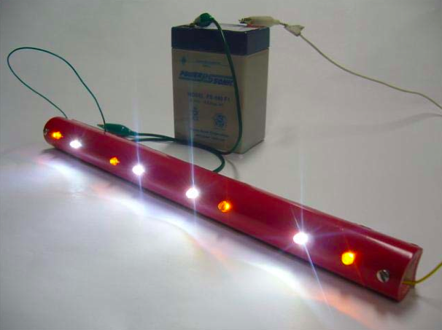
+ Story
More proto testing of different technologies
Burmese Villager
$5 max

Slide 92
Investors
+ Story

Slide 93
Burmese
Political &
Legal
Issues
Investors
Population
too small

Slide 94
+ Story
India
User testing
Empathy

Slide 95
India
Proto
Iterations
Redefine needs, insights

Slide 96
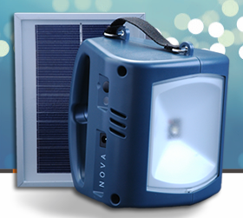
+ Story
India
Proto
Iterations
Redefine needs, insights

Slide 97
Be mindful of when you choose to apply the viability lens

